Slide 1

Software for Synthetic Biology Workflows
The Synthetic Biology Open Language
Jake Beal, Raytheon BBN Technologies
Ernst Oberortner, JBEI/JGI
Tramy Nguyen, U Utah
Nicholas Roemer, Raytheon BBN Technologies
Kevin Clancy, Synthetic Genomics

Slide 2
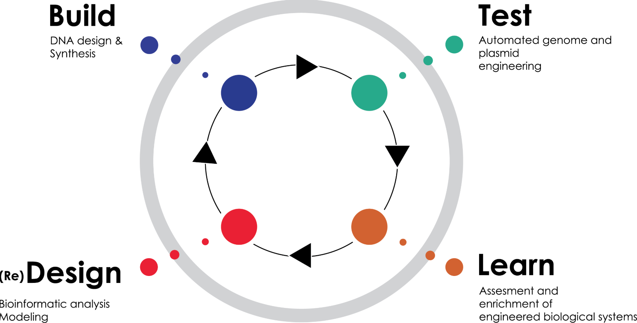
Purpose of the Workshop
SBOL has been adopted by many developers
www.sbolstandard.org
28 separate applications
Now the question becomes:
What do I need to use?
How do I use it?
This workshop will:
Show you how to get and convert sequences to and from SBOL
Show you how to construct your designs
Show you how to get your designs built
Show you how to save & share your designs

Slide 3
How We have Organized This Workshop
You can follow the instructions as I perform them
You can download the data and tutorials from GitHub
www.github.com/MadraghRua/SEED-Workshop-2018.git
You can copy the data, tutorials from USB drives I have with me
Tutorials are organized by Software we will be using
Jake, Ernst, Tramy and Nick will be available on the floor as we go through the demonstrations
Don’t hesitate to ask questions as we move along
Overall goals
You should be able to use the tools we demo today
You can continue your training by following the other training modules we have included with the content

Slide 4
Example 4 - BOOST
We will:
Use the Workflow Manager to set up a Gene Synthesis request
Upload a GenBank file
Set up parameters for codon juggling and synthesis
Set up parameters for partitioning of sequence blocks
Specify an output
Inspect the output
Build-OptimizatiOn Software Tools (BOOST) is a platform of tools to design DNA sequences for manufacturing.
Currently, BOOST consists of three tools:
(i) The "Juggler" reverse translates protein sequences into DNA sequences and
codon juggles DNA sequences,
(ii) The "Polisher" verifies DNA sequences against DNA synthesis constraints. The "Polisher"
can modify the protein coding regions of DNA sequences in order to resolve eventual violations of DNA synthesis constraints.
(iii) The "Partitioner" decomposes large DNA sequences into synthesizable building blocks with assembly-specific overlap
sequences.
Contact Person: Ernst Oberortner Organization(s): DOE Joint Genome Institute, Lawrence Berkeley National Labs
https://boost.jgi.doe.gov/boost.html

Slide 5
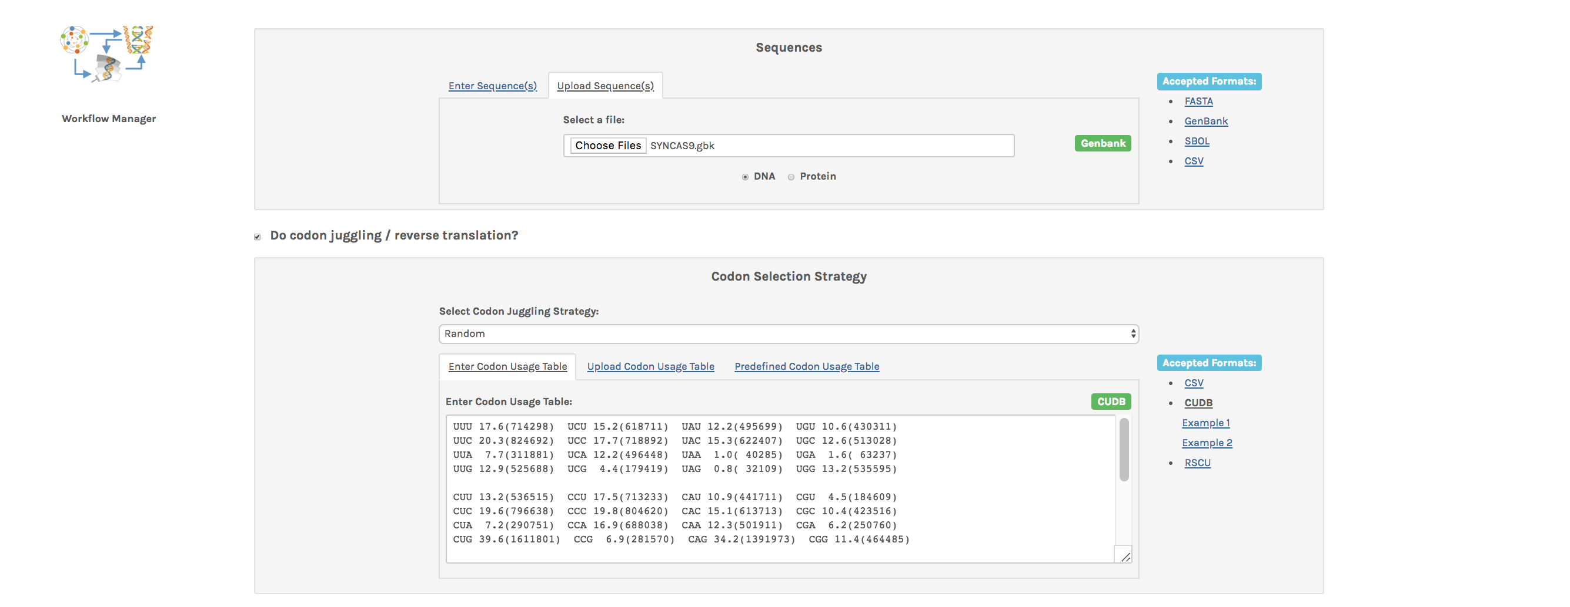
ACTIONS
Log into BOOST via this URL: https://boost.jgi.doe.gov
You need to set up a new account
Select the SYNCAS9.gbk file from Example 4 to upload to the web site
Select the HomoSapiens codon usage table for Codon juggling

Slide 6
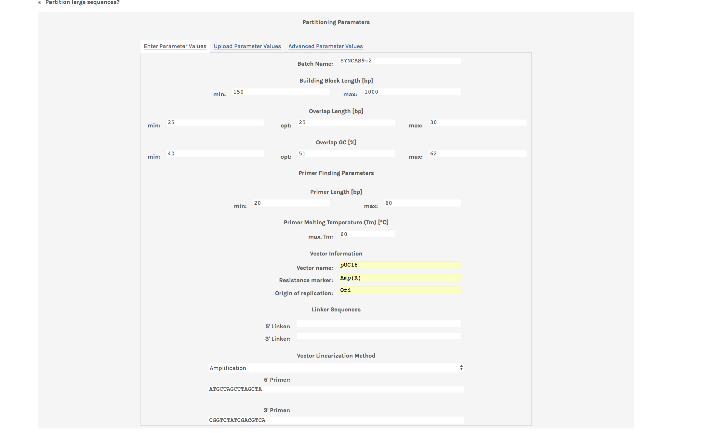
ACTIONS
Give your file a Batch name, eg SYNCAS9-1
Adjust Block length to 1000
Use a maximal primer length of 60
Populate the Vector fields with information
Select Vector amplification and add appropriate primer sequences

Slide 7
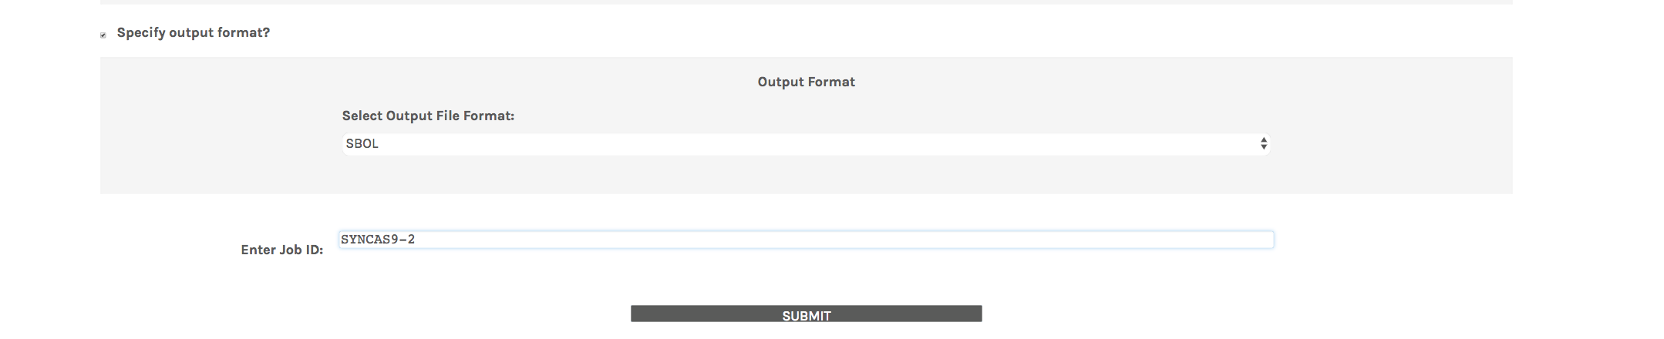
ACTION
Select SBOL as an output format
Enter a job id
Submit!

Slide 8
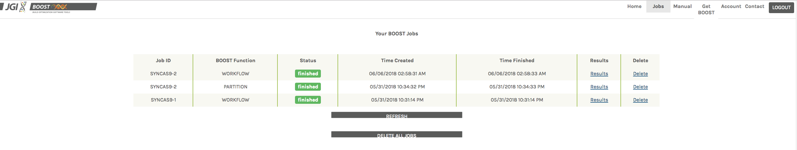
The dash board will show the status of your requests.
ACTION
Select Results to retrieve the result file

Slide 9
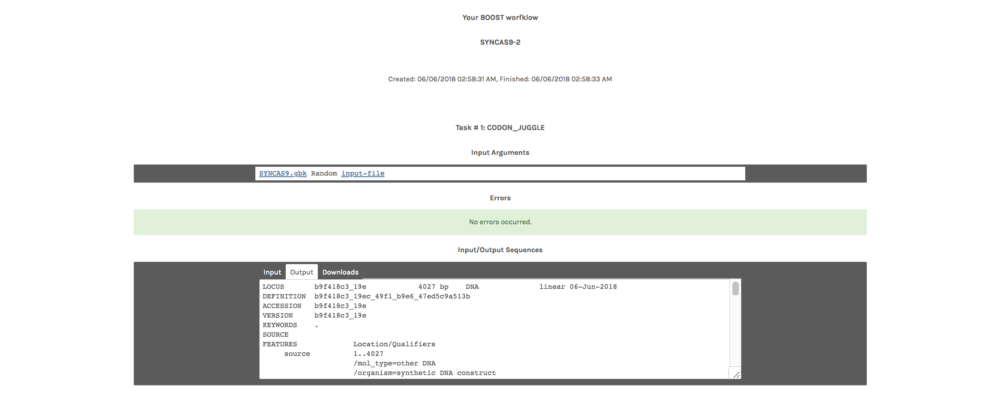

Slide 10
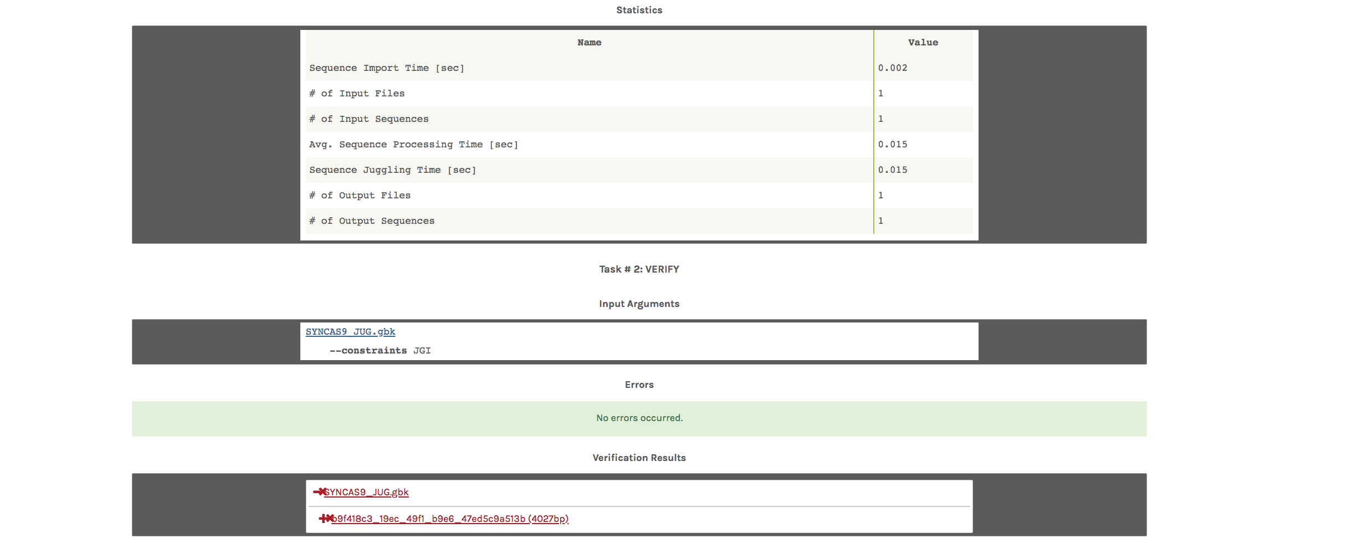

Slide 11
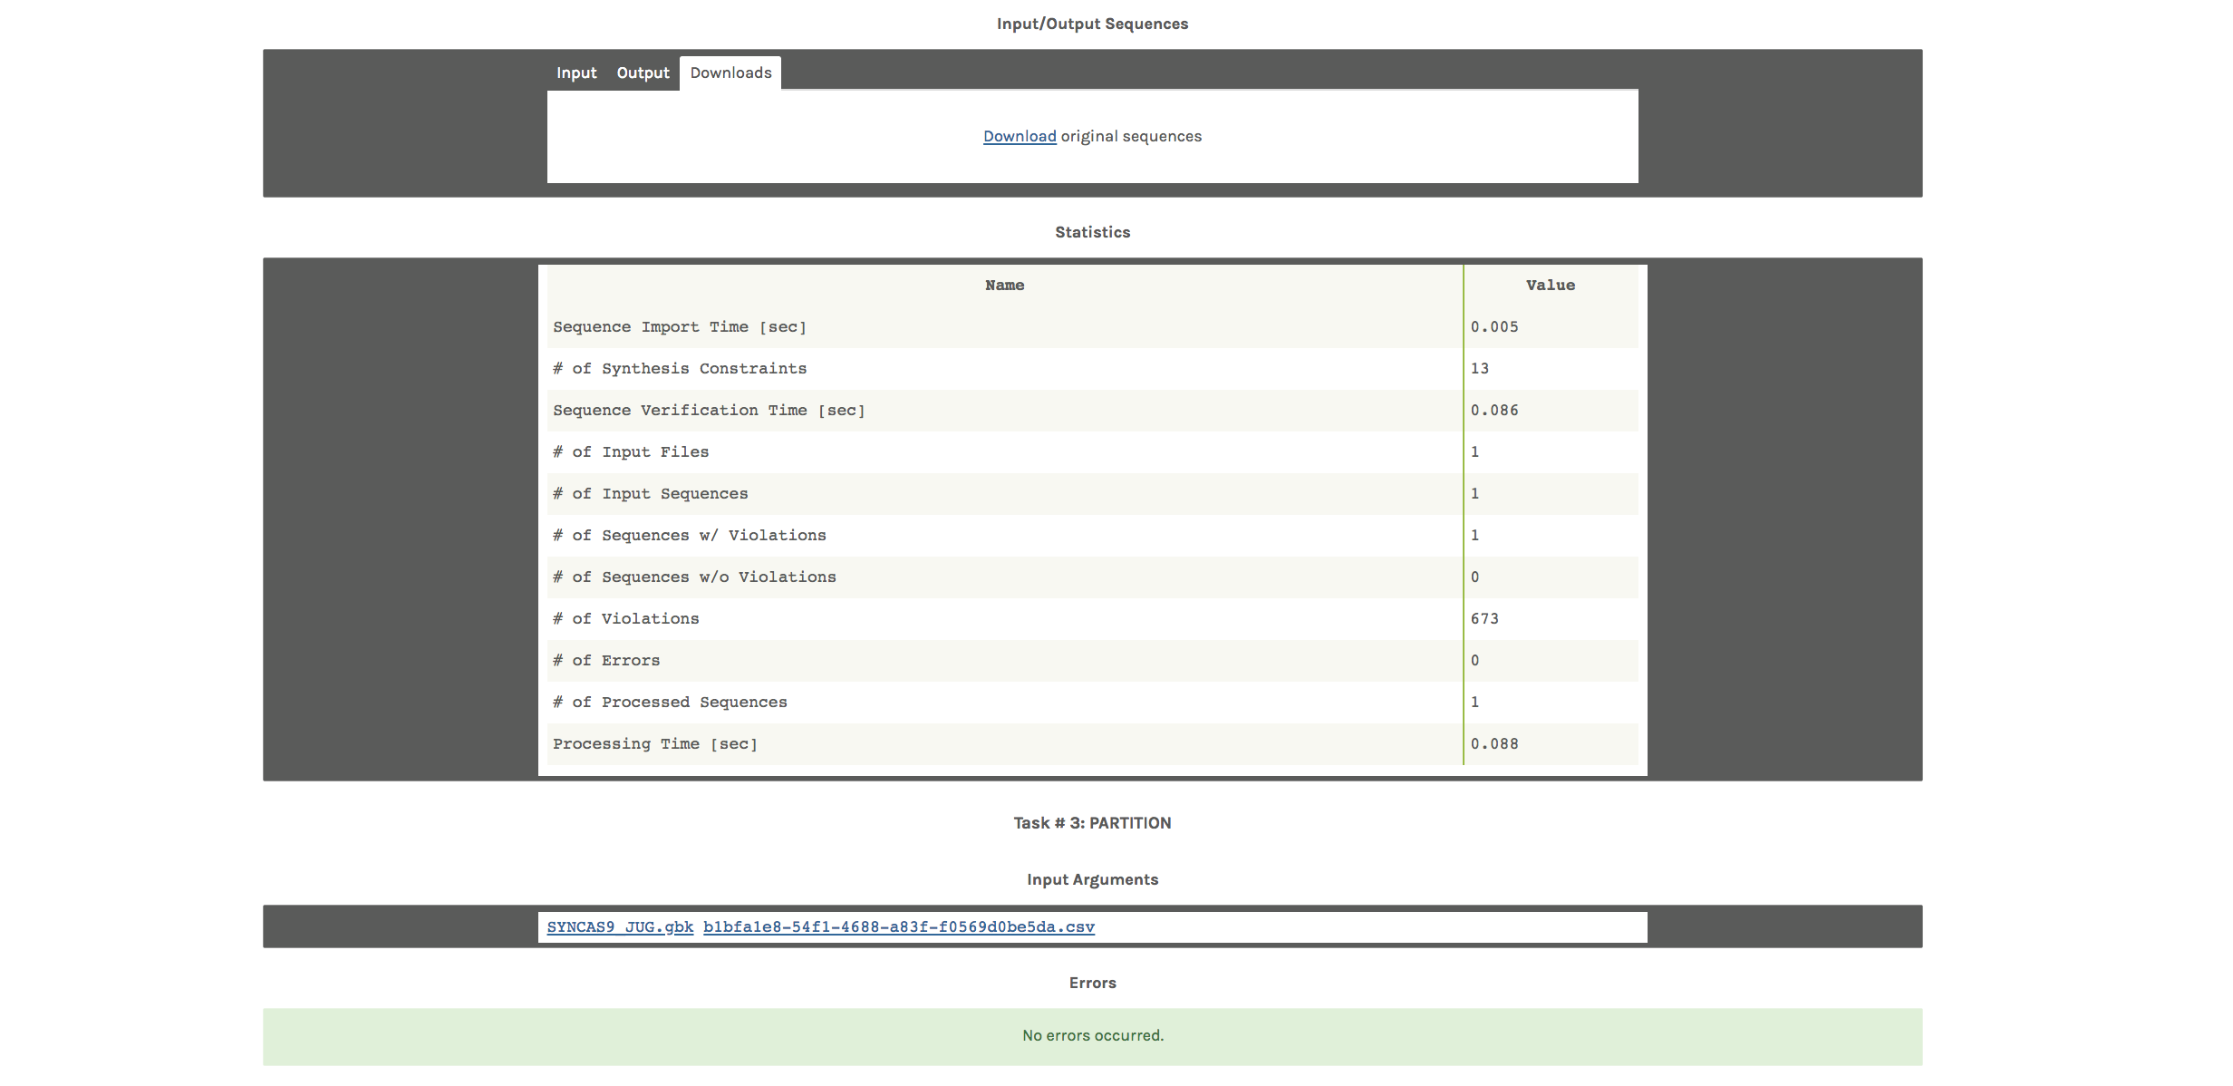

Slide 12
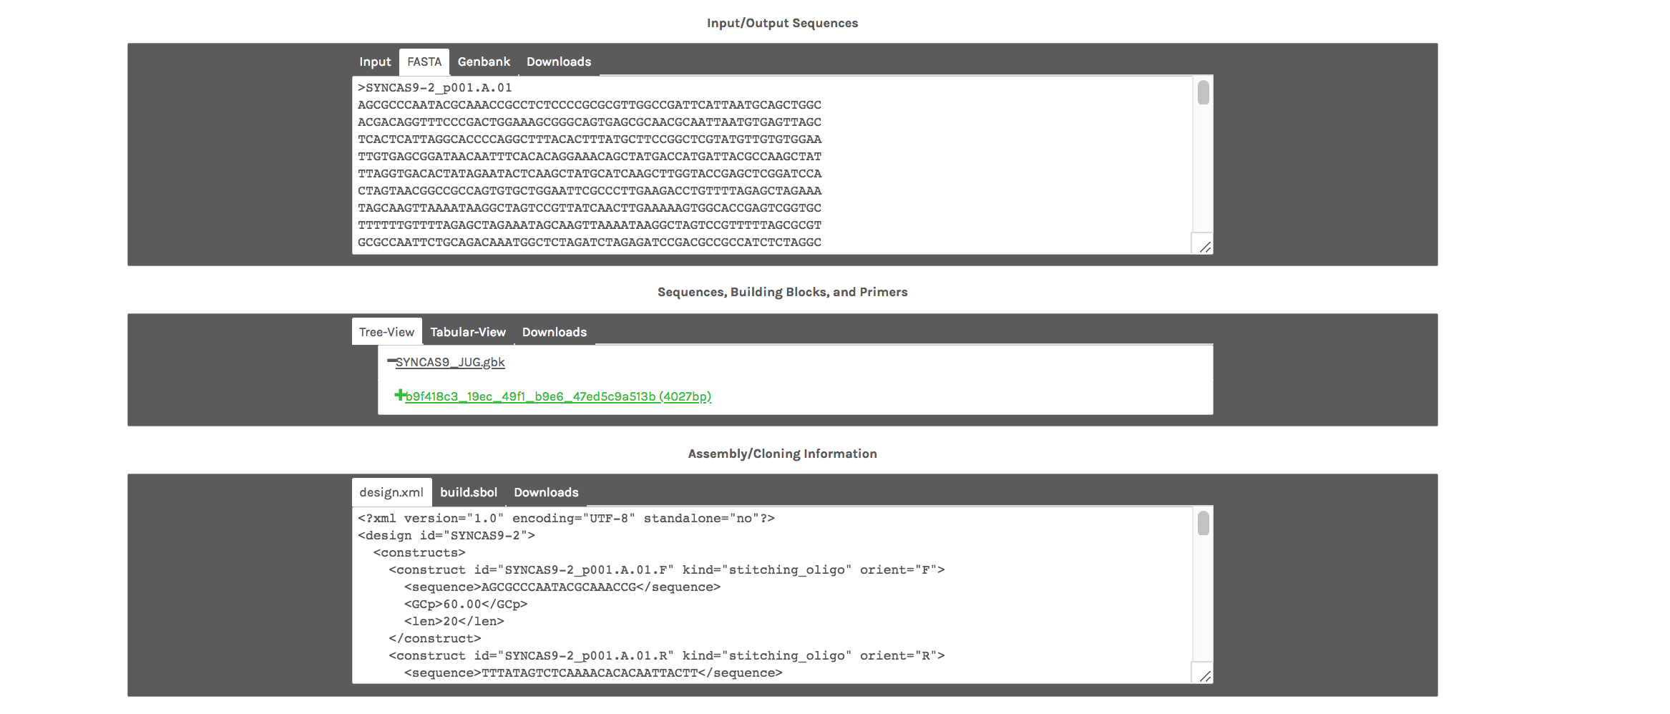

Slide 13
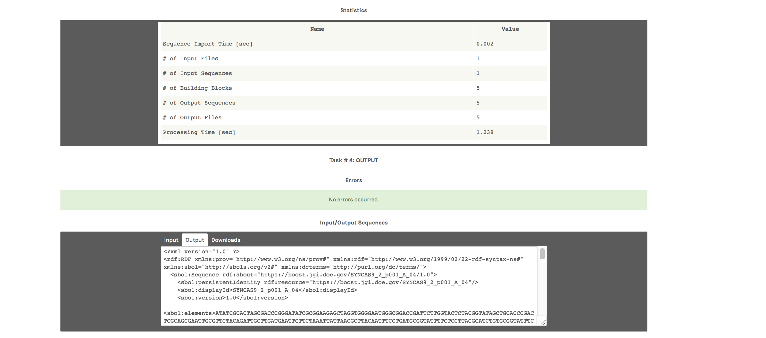
ACTIONS:
Select Downloads
Output both the Original and Juggled files in SBOL format
Open them in SBOLDesigner

Slide 14
Example 4 Summary
We:
Used the Workflow Manager to set up a Gene Synthesis request
Uploaded a GenBank file
Set up parameters for codon juggling and synthesis
Set up parameters for partitioning of sequence blocks
Specified an output
Inspected the output

Slide 15
Example 5 – Gene Genie
We will:
Use GeneGenie to design oligos for an in-house synthesis reaction
Select a protein sequence and add it to the web page
Adjust parameters for oligo designs
Run and analysis
Inspect some of the output files

Slide 16
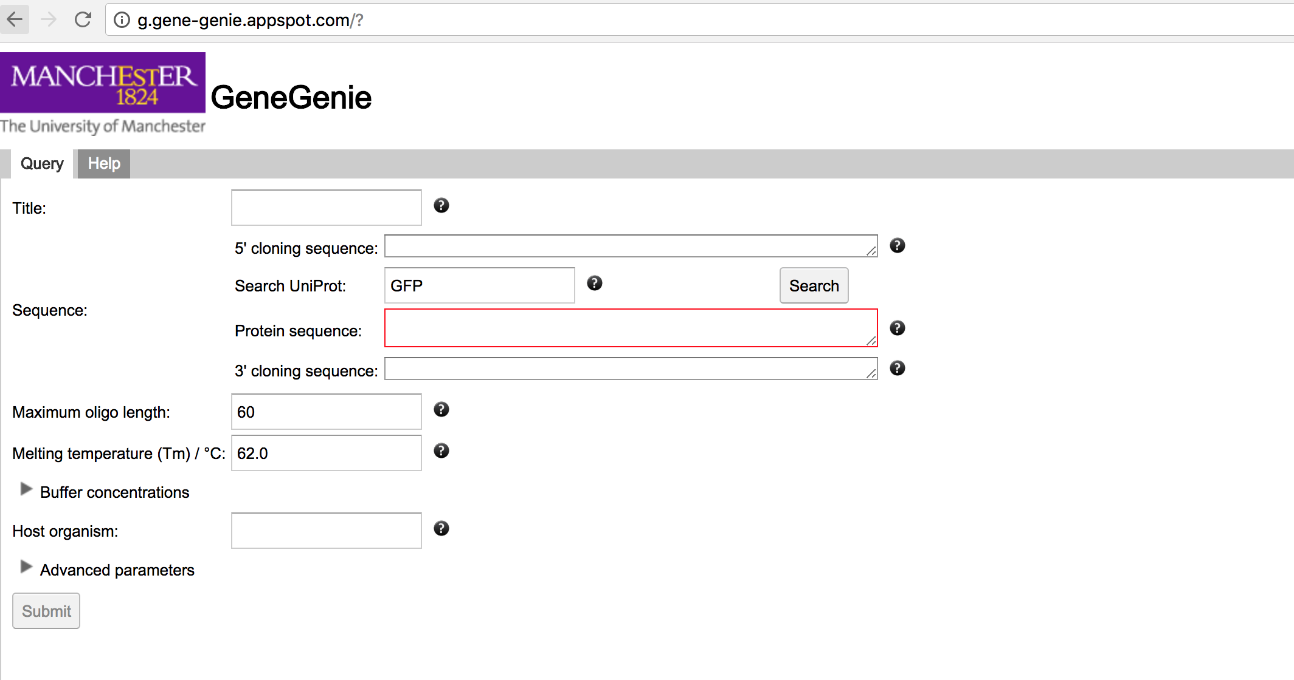
GeneGenie supports the design and self-assembly of synthetic genes and constructs. GeneGenie allows for the design of oligonucleotide cohorts encoding the gene sequence optimized for expression in any suitable host through an intuitive, easy-to-use web interface. The tool ensures consistent oligomer overlapping melting temperatures, minimizes the likelihood of misannealing, optimizes codon usage for expression in a selected host, allows for specification of forward and reverse cloning sequences and also provides support for mutagenesis or directed evolution studies
Contact Person: Neil Swainston Organization(s): Manchester Centre for Synthetic Biology of Fine and Specialty Chemicals (SYNBIOCHEM)
http://g.gene-genie.appspot.com/?

Slide 17
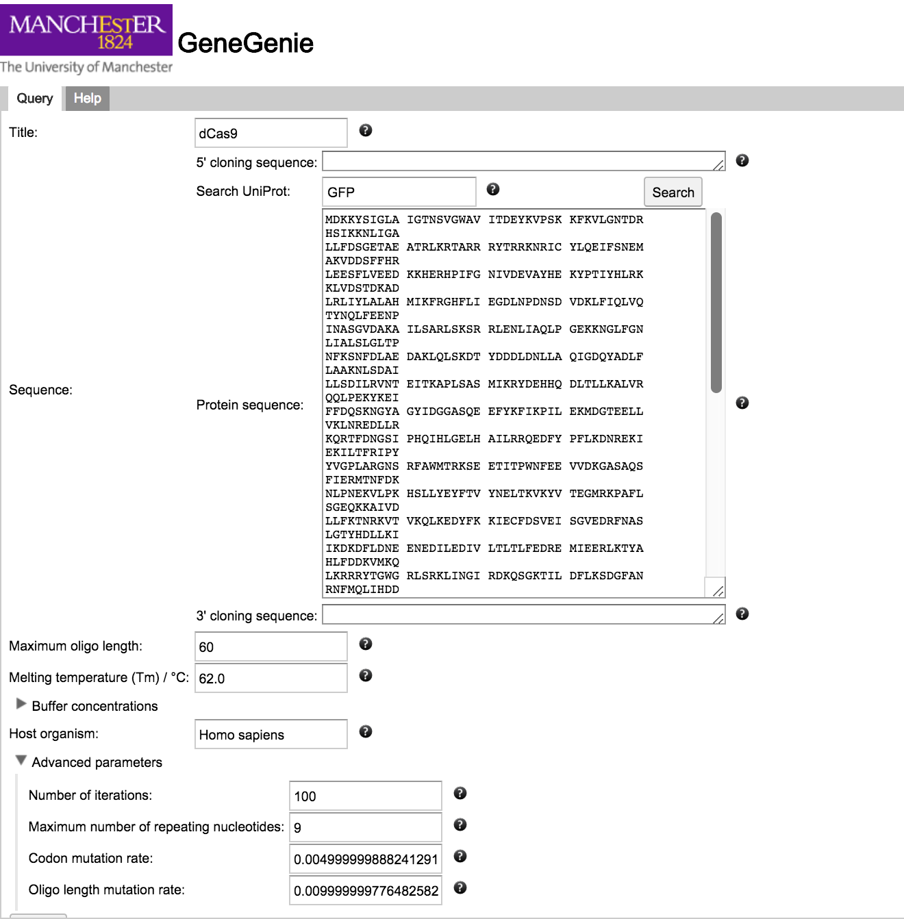
ACTIONS
In the Example 5 – GeneGenie folder open the KR)11748.gbk file with a text editor.
Select the translated dCAS9 protein sequence
Paste it into the Protein Sequence box
Type Homo sapiens as your Host organism
Under advanced parameters select 100 iterations
Change maximum number of repeating nucleotides to 9
Submit

Slide 18
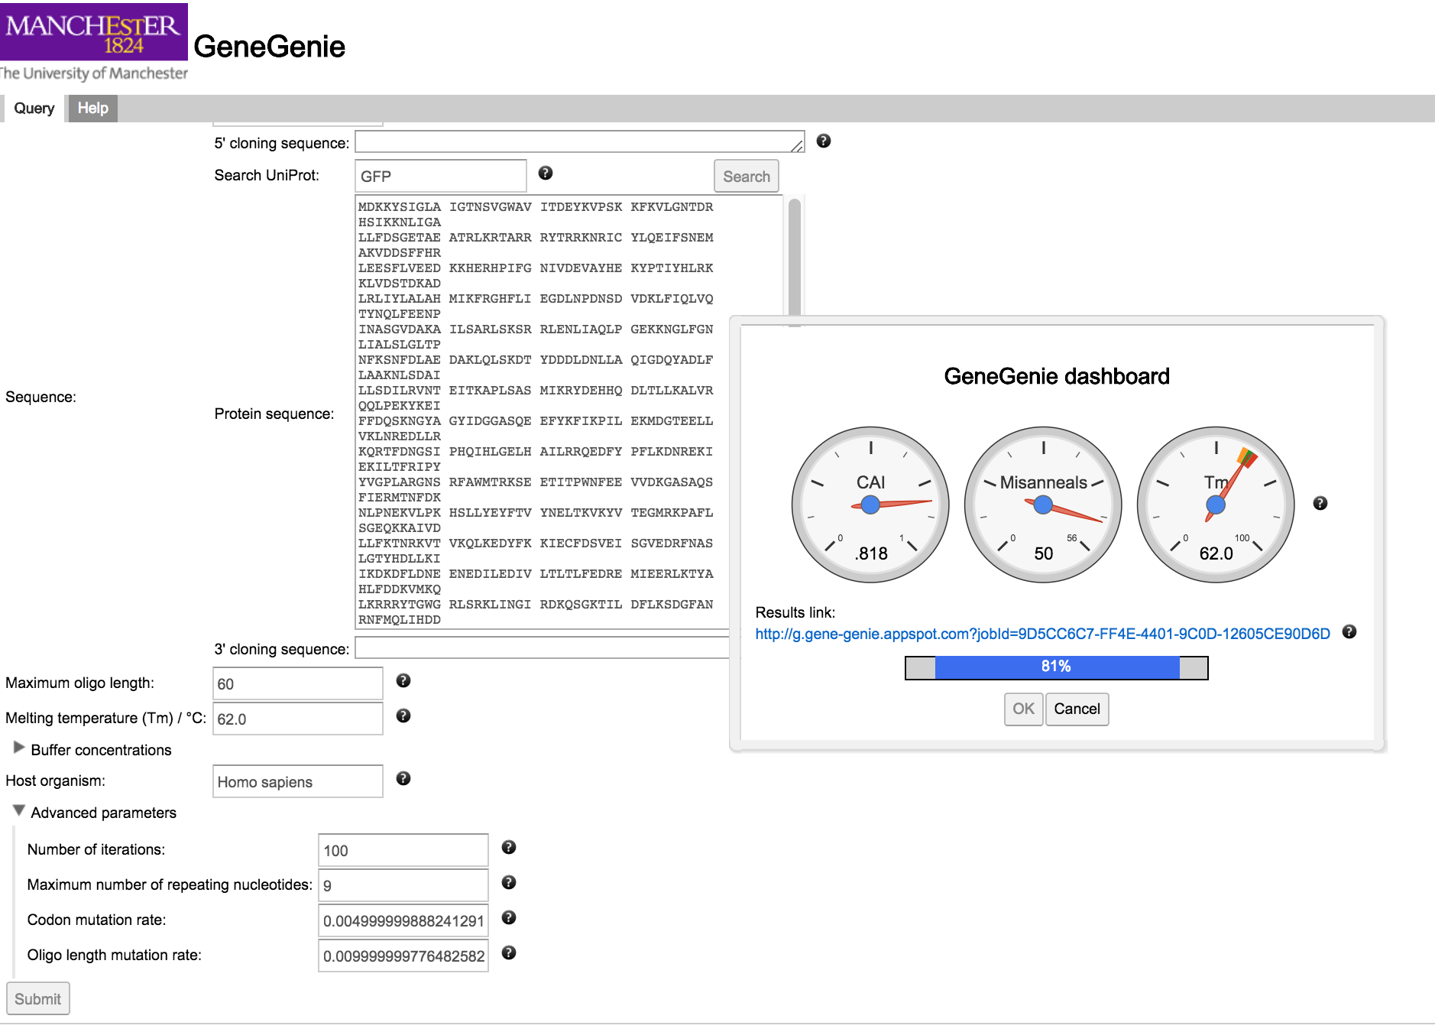
The software has a very nice progress meter indicating the parameters the algorithm is juggling

Slide 19
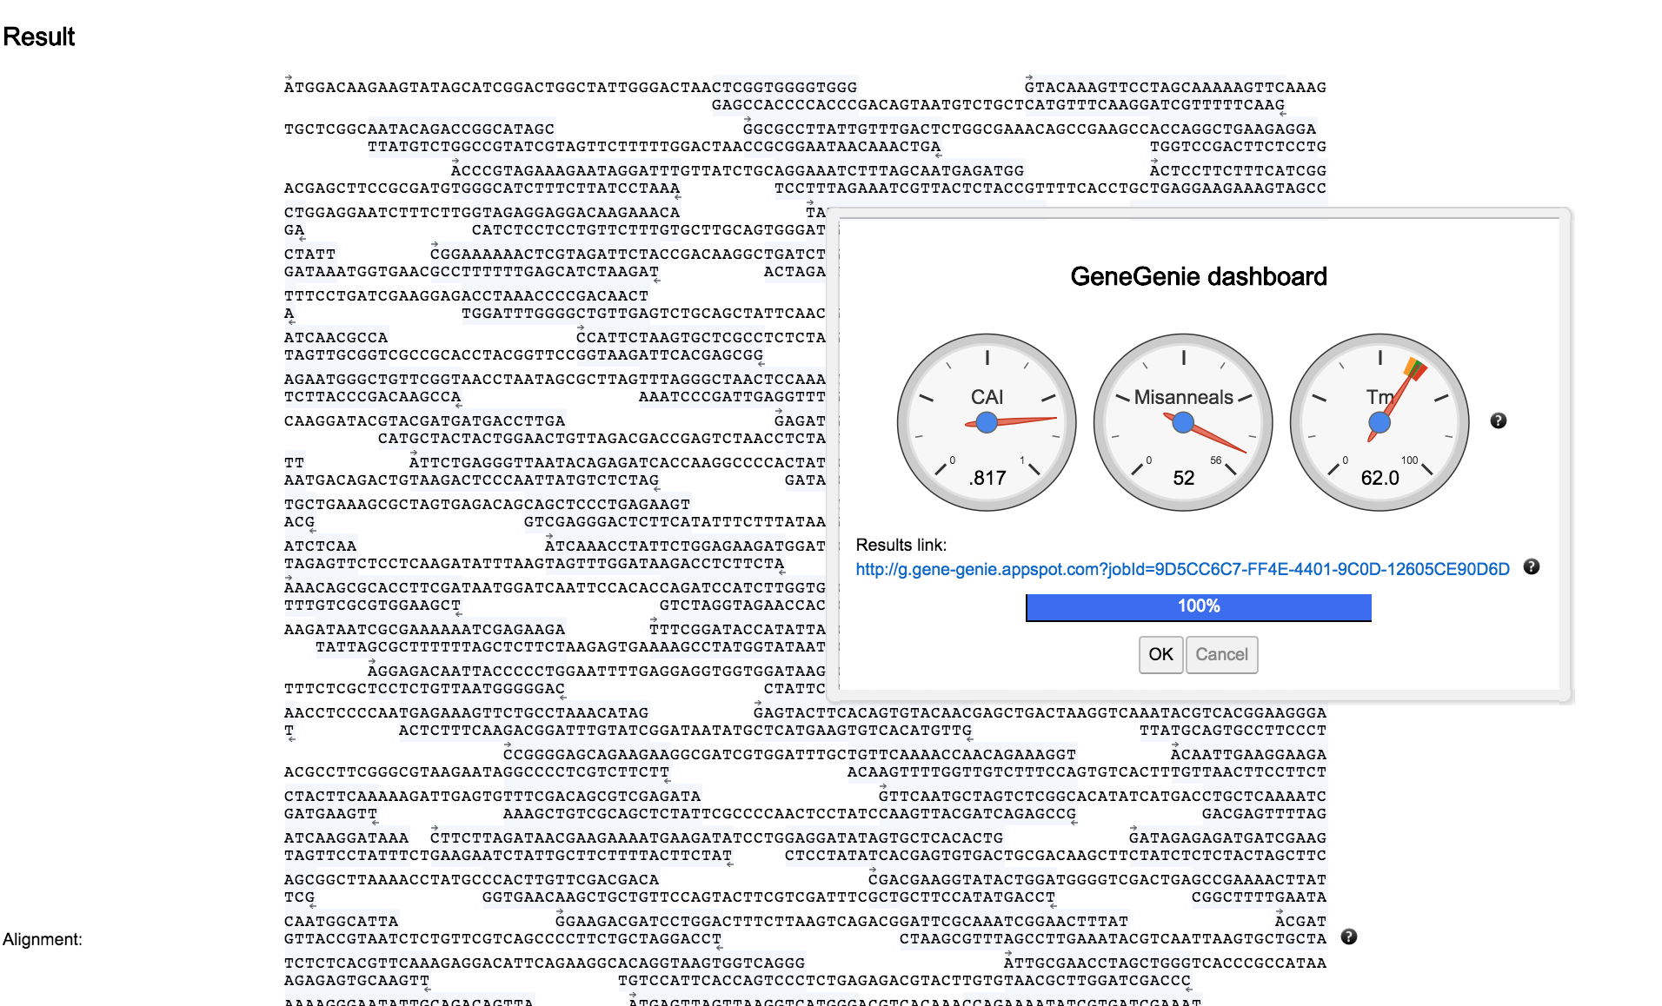
When competed you can
save the web page
Scroll down to the Oligos table and export this in SBOL format
You can visualize this in SBOL designer
You can add these as sub-elements in an Engineered Region design as well

Slide 20
Example 5 Summary
We:
Selected a protein sequence and added it to the web page
Adjusted parameters for oligo designs
Ran an analysis
Inspected some of the output files

Slide 21
Example 6 - VizBol
We will:
Use VizBol to develop publication quality graphics
VisBOL is a JavaScript software library to visualize DNA features from SBOL2 documents using the SBOL Visual standard. A Web interface is also provided to enable end-user access to generate diagrams for presentations and publications.
Contact Person: Anil Wipat Organization(s) : Newcastle
http://www.vizbol.org
University

Slide 22
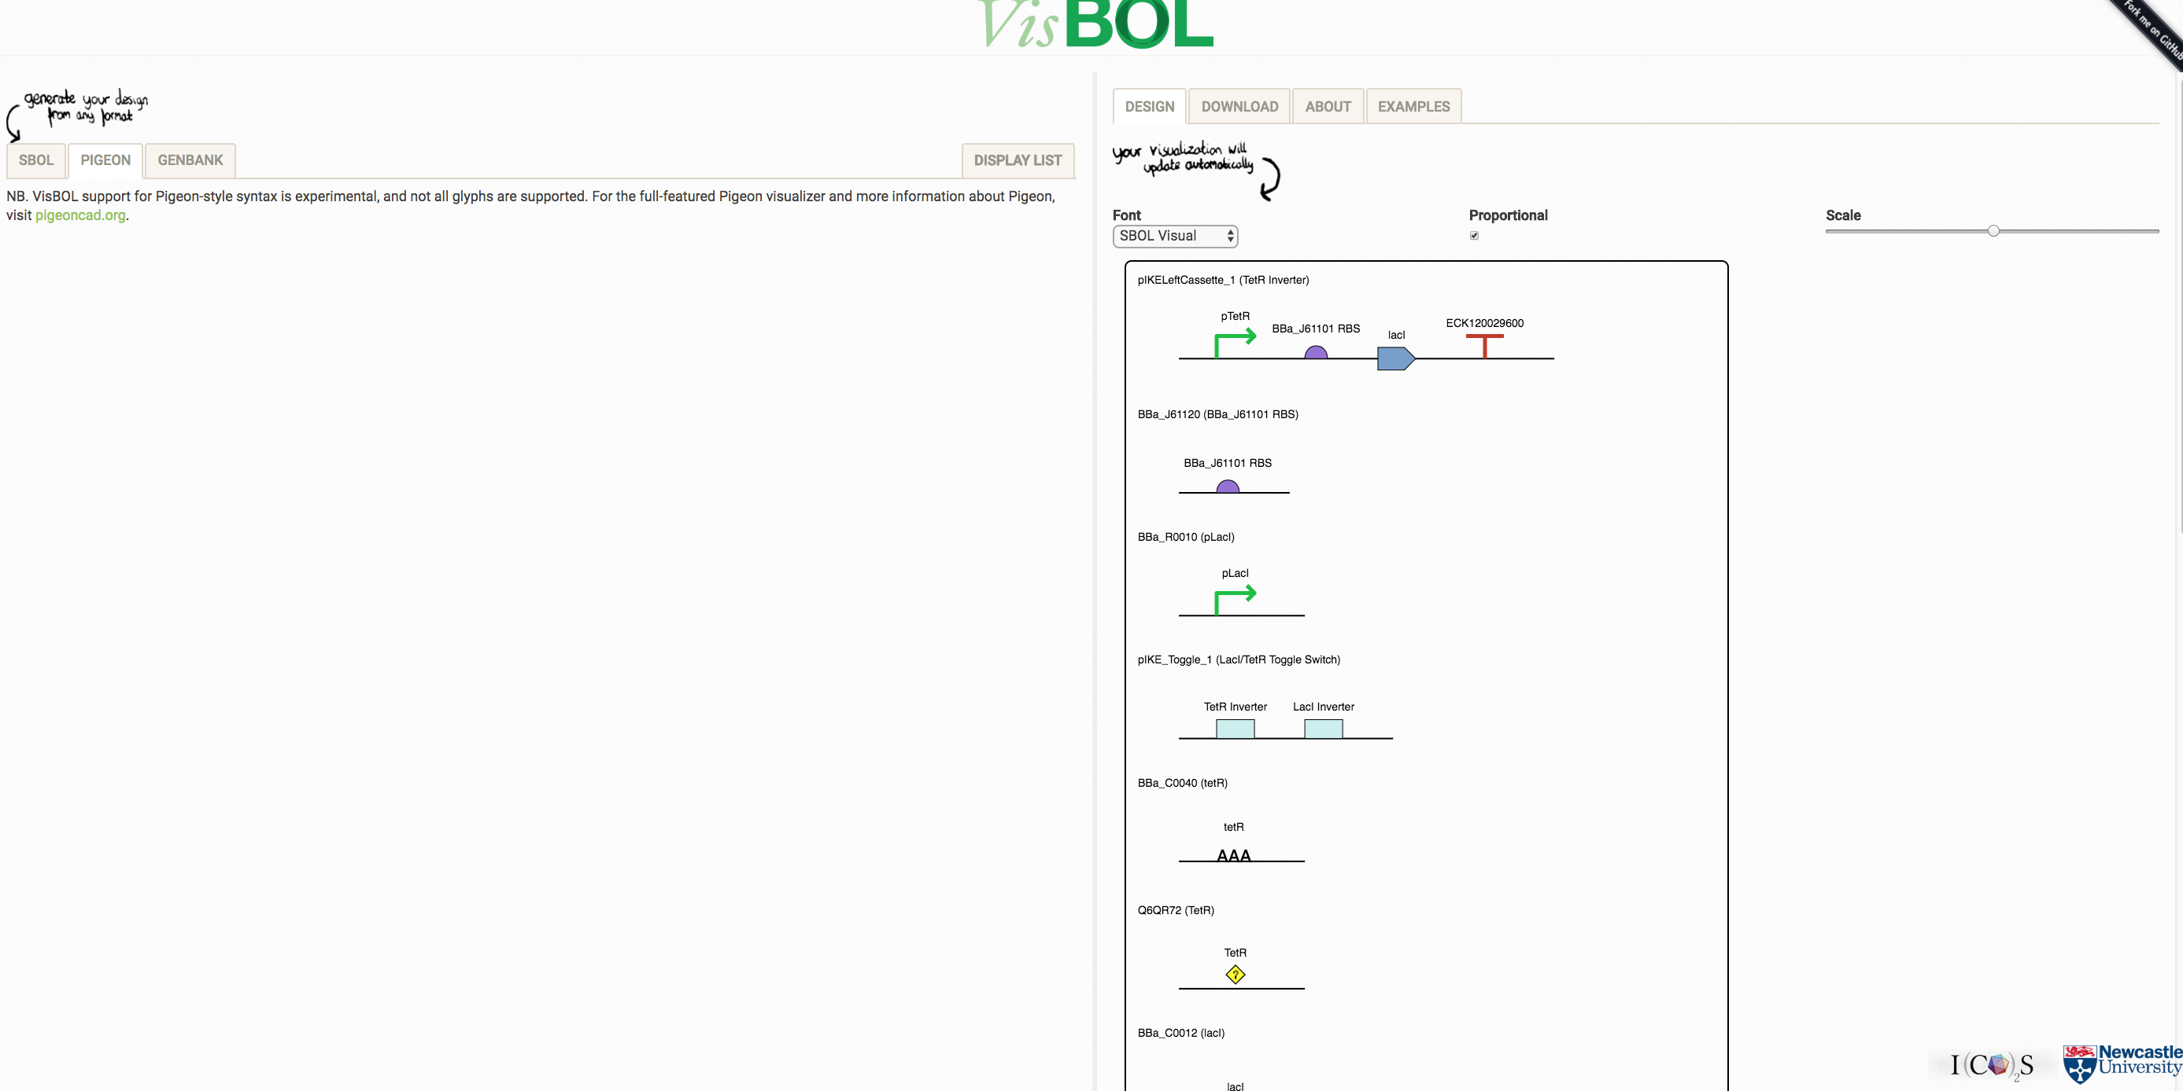
ACTION
Open the Example 6 folder and open the file KR011748.rdf
Copy this
Select the SBOL tab
Select the existing SBOL data and paste in your rdf data

Slide 23
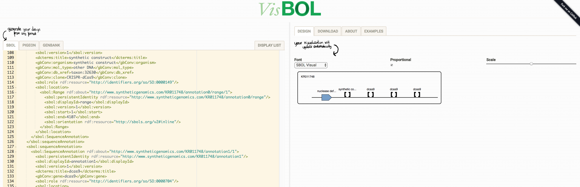
ACTION
Select Download to get copies of the images
Check out the examples
Use the files you have already generated to make more images

Slide 24
Example 6 Summary
We:
Used VizBol to develop publication quality graphics

Slide 25
Example 7 iBioSim
We will:
Used iBioSim to develop a model for CRISPR mediated inhibition of SOD1 expression
Integrate this with a systems model of the switch
Export both SBML and SBOL representations of our design
iBioSim has been developed for the modeling, analysis, and design of genetic circuits. While iBioSim primarily targets models of genetic circuits, models representing metabolic networks, cell-signaling pathways, and other biological and chemical systems can also be analyzed. It can importing and exporting models using all levels and versions of SBML. It interates pathway daya with Synthetic Biology by supporting the Synthetic Biology Open Language (SBOL), an emerging standard for information exchange in synthetic biology.
Contact Person: Chris Myers Organization(s): University of Utah
http://www.async.ece.utah.edu/ibiosim

Slide 26
Installation Details
iBioSim needs Java to run
In the GitHub repository we have a Java folder with a recent version of the softwares.
In the Example 7 – iBioSim folder we have a recent version of the software
Double click the zip file to extract it
If the computer objects you will need to install Java from the Java folder or download it from Oracle
https://java.com/en/download/
iBioSim is always available through
https://github.com/SynBioDex/SBOLDesigner/releases

Slide 27
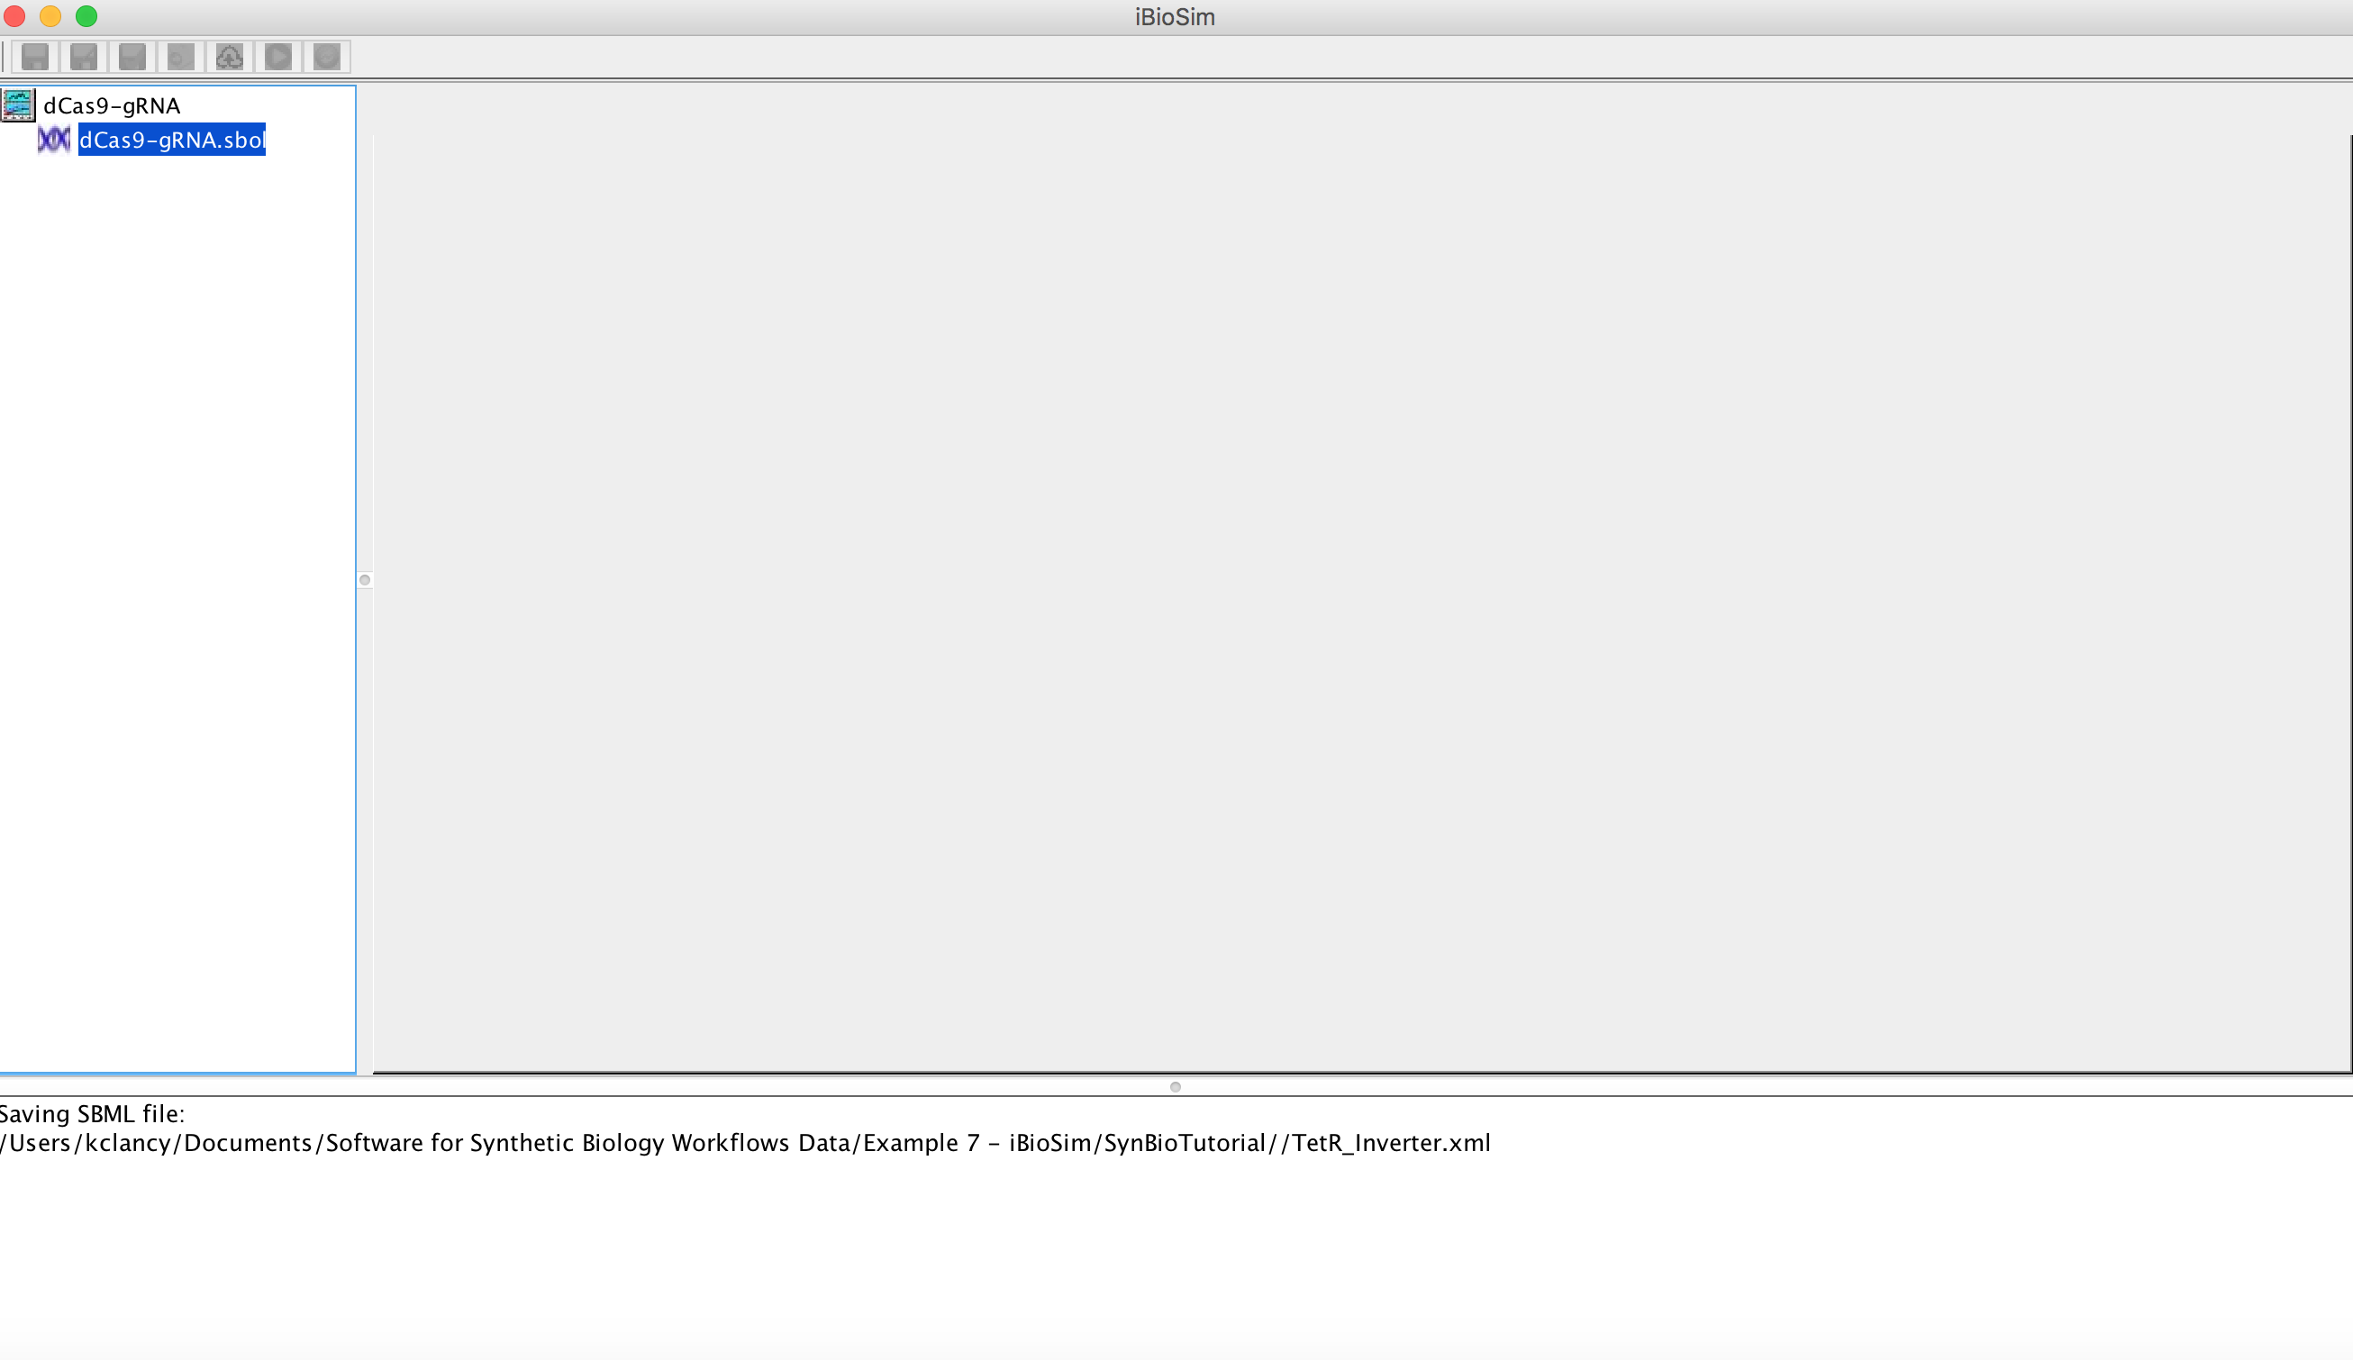
ACTION
File->New->Project
Create a Folder – dCas9-gRNA
Create a Project File – dCas9-gRNA

Slide 28
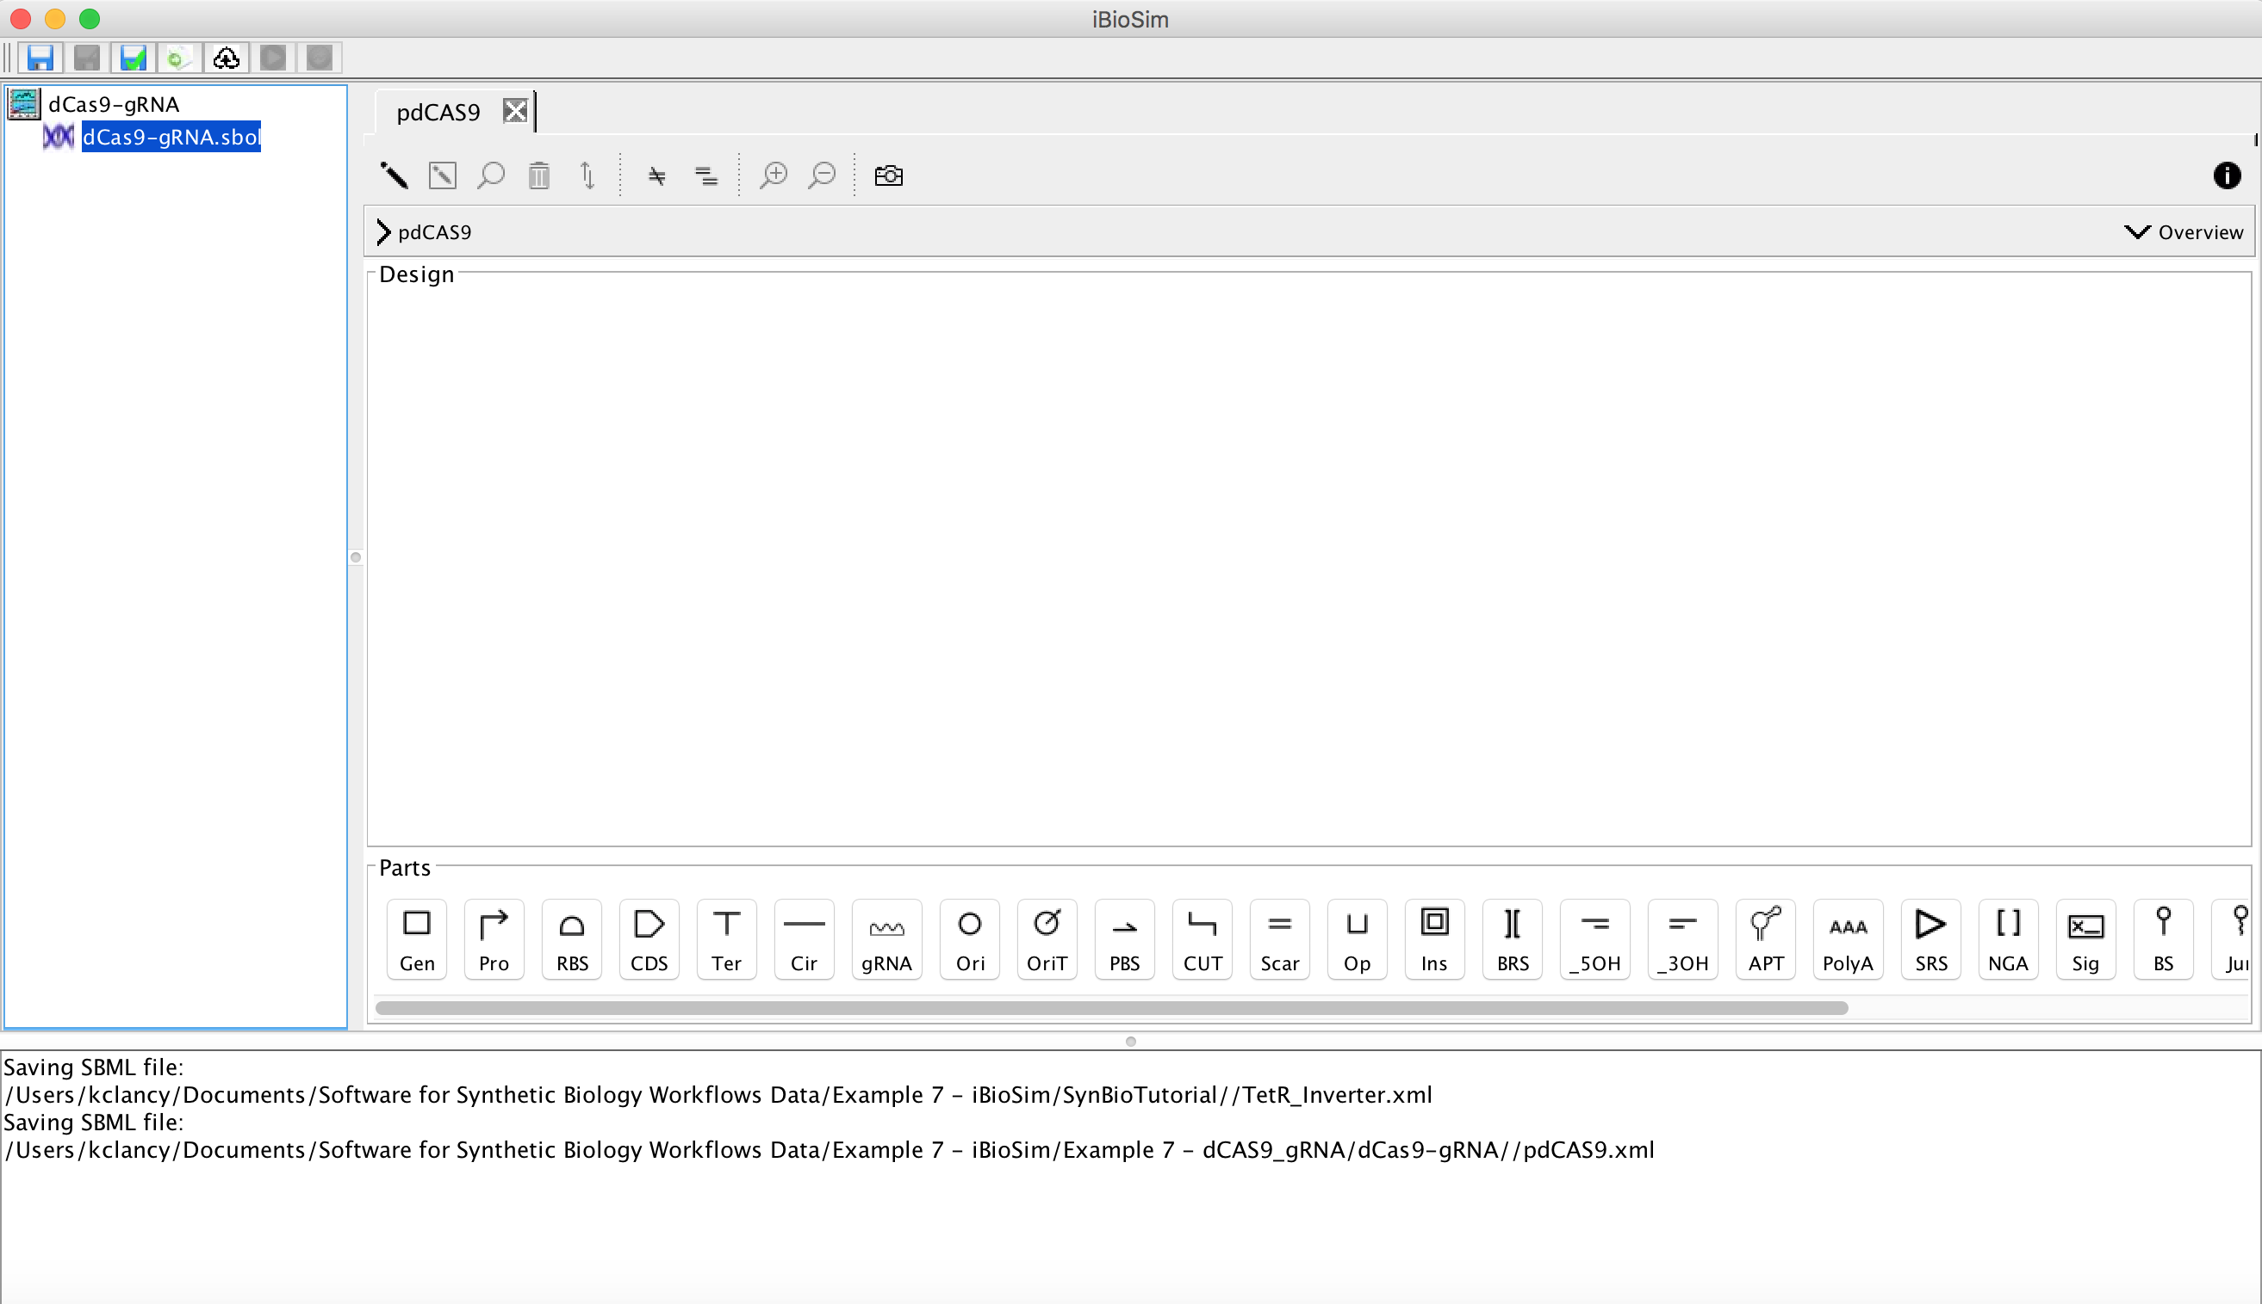
ACTION
File->New->Design
Create a Design File – pdCas9
You have now launched an SBOLDesigner module that is part of iBioSim
Now create a new pdCas9 – Promoter, Engineered Region & Terminator
Hint – use the Import part button to navigate to the design you created in exercise 2

Slide 29
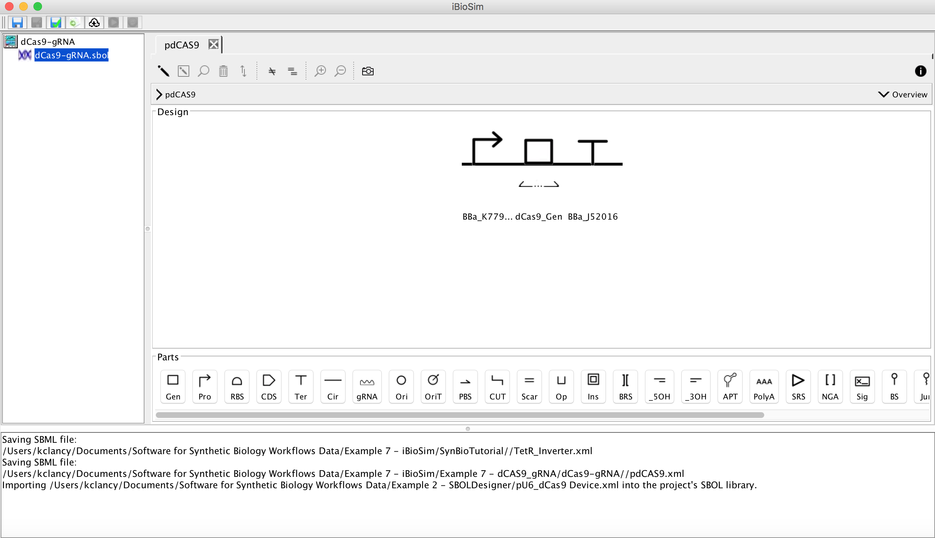
You should have a design like this now. Save your design.
Now you need a gRNA design.
ACTION
File->New->Design
Name it pgRNA
Browse the registry for the necessary parts…

Slide 30
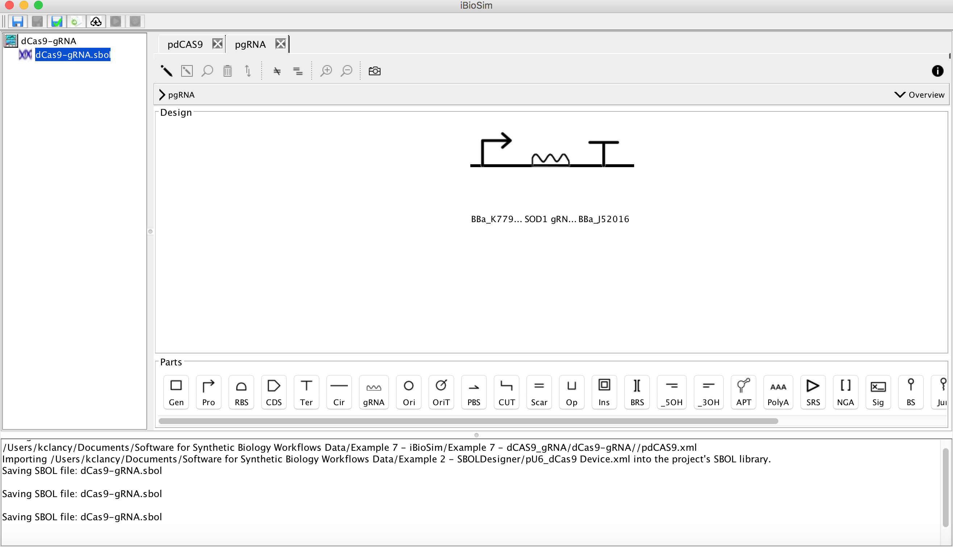
ACTION
File->New->Design
Name it pgRNA
Browse the Example 7 Folder for the pgRNA.sbol file
Import the parts

Slide 31
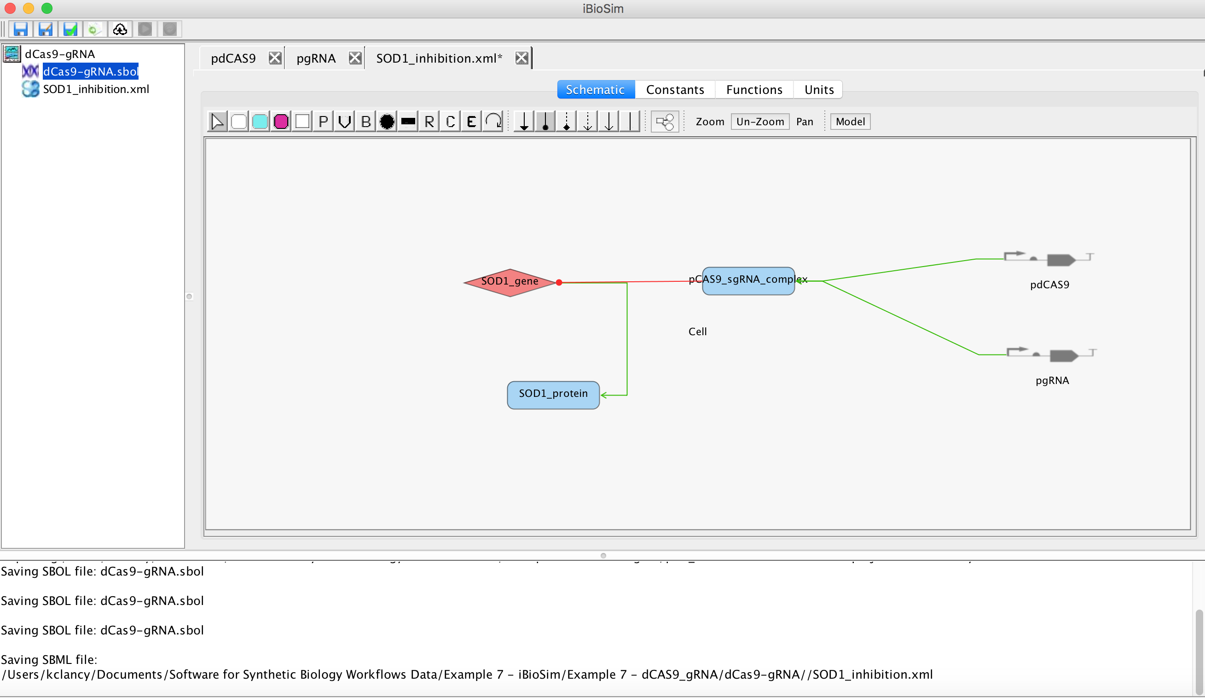
ACTION
File->New->Model
Name it SOD1_inhibition
File->Import->Model->SBML Model
Browse to SOD1_inhibition.sbml and import this.

Slide 32
Example 7 Summary
We:
Used iBioSim to develop Designs for CRISPR mediated inhibition of SOD1 expression
Integrated this with a systems model of the model
Export both SBML and SBOL representations of our designs

Slide 33
Conclusions
We have given you a tour of how to get and use SBOL resources to create & share your own designs
We have used these designs to develop experimental materials to build
We have used these designs to develop models of how the designs will work within your biological system

